Slide 1



Noida Institute of Engineering and Technology, Greater Noida
Computer Networks
Unit: 5
Computer Network: Application Layer
Ms. Akanksha
Asst. Professor
ECE
B Tech 5th Sem

Slide 2
Content
Course Objective
Course Outcome
CO-PO matrix
CO-PSO matrix
Introduction to Application Layer
Application Layer Protocols

Slide 3
Course Objective
Introduction of computer networks with suitable transmission media and different networking devices. Network protocols which are essential for the computer network are need to explain such as data link layer protocols and routing protocols.
A detail explanation of IP addressing , TCP/IP protocols and application layer protocols are covered in this course.

Slide 4
Course Outcome
At the end of semester students will be able to
CO1:Explain basic concepts, OSI reference model, services and role of each
layer of OSI model and TCP/IP, networks devices and transmission
media, Analog and digital data transmission.
CO2: Apply channel allocation, framing, error and flow control techniques.
CO3: Describe the functions of Network Layer i.e. Logical addressing,
subnetting & Routing Mechanism.
CO4: Explain the different Transport Layer function i.e. Port addressing,
Connection Management, Error control and Flow control mechanism.
CO5: Explain the functions offered by session and presentation layer and their Implementation.
CO6: Explain the different protocols used at application layer i.e. HTTP,
SNMP, SMTP, FTP,TELNET and VPN.

Slide 5
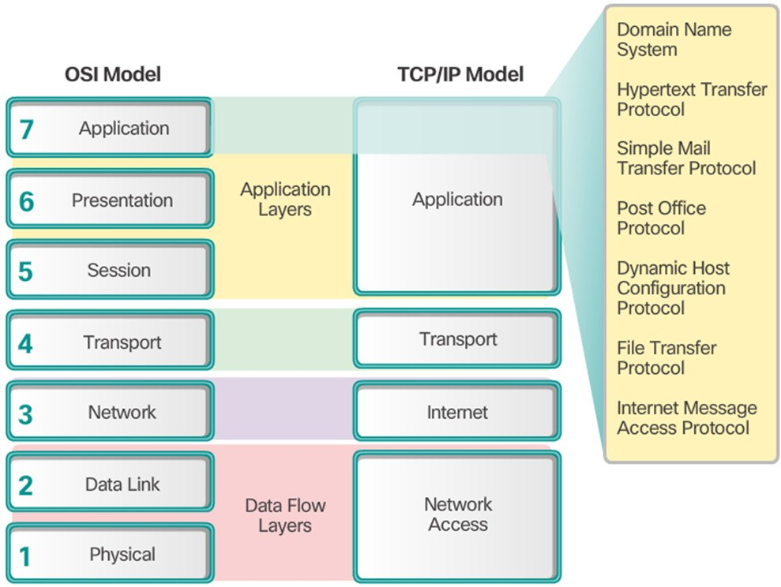
Application Layer
Objective: Study about basic concept Application layer and its function
The application layer is closest to the end user.
Network applications enable users to send and receive data with ease.
The application layer acts as interface between the applications and the underlying network.
Application layer protocols help exchange data between programs running on the source and destination hosts.
The TCP/IP application layer performs the functions of the upper three layers of the OSI model.
Common application layer protocols include: HTTP, FTP, TFTP, DNS.

Slide 6
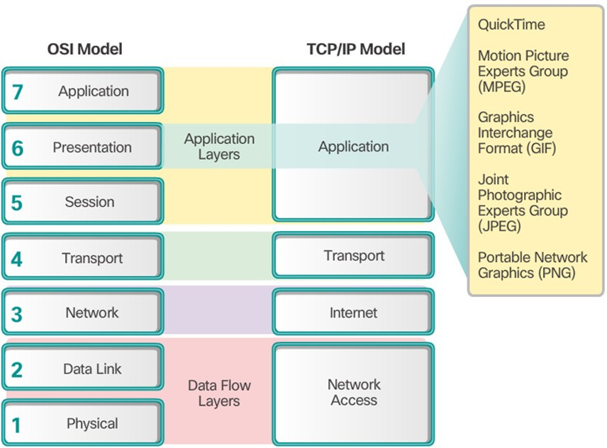
Session Layer
The session layer creates and maintains dialogs between source and destination applications.
The session layer handles the exchange of information to initiate dialogs, keep them active, and to restart sessions that are disrupted or idle for a long period of time.

Slide 7
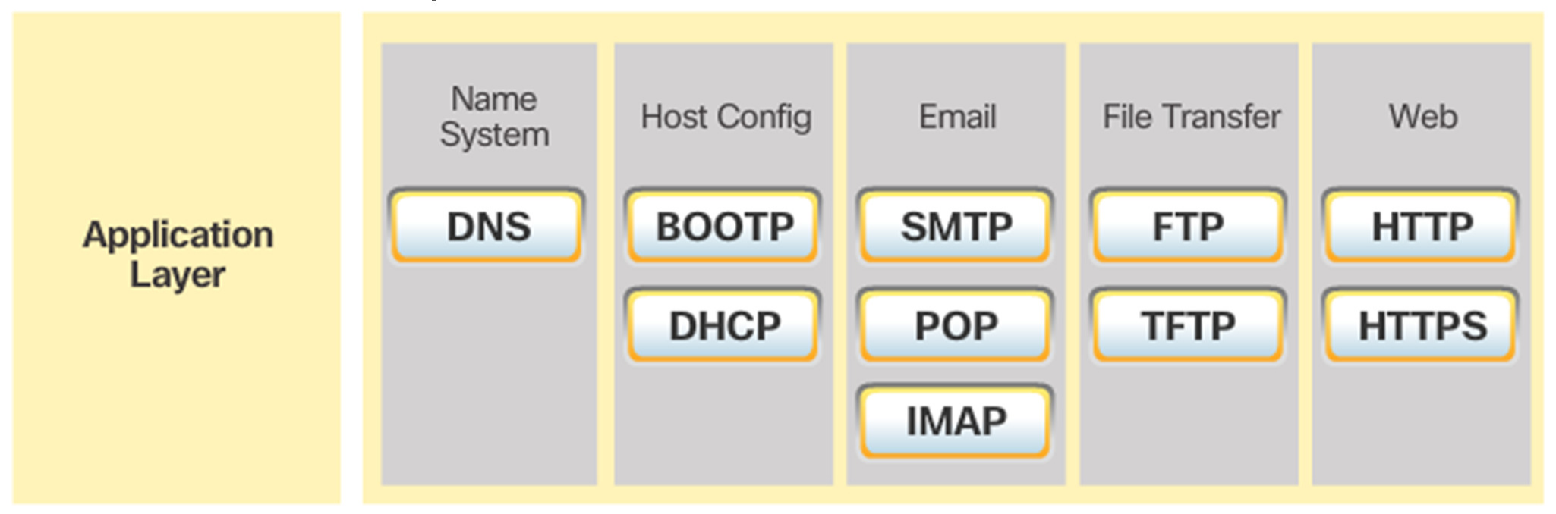
Application Layer Protocols
TCP/IP application protocols specify the format and control information necessary for common Internet functions.
Application layer protocols must be implemented in both the source and destination devices.
Application layer protocols implemented on the source and destination host must be compatible to allow communication.

Slide 8
Application Layer services
1.Network Virtual terminal:
An application layer allows a user to log on to a remote host. The user's computer talks to the software terminal, which in turn, talks to the host. The remote host thinks that it is communicating with one of its own terminals, so it allows the user to log on.
2.File Transfer, Access, and Management :
An application allows a user to access files in a remote computer, to retrieve files from a computer and to manage files in a remote computer.

Slide 9
Application Layer services
3.Addressing:
To obtain communication between client and server, there is a need for addressing. When a client made a request to the server, the request contains the server address and its own address. The server response to the client request, the request contains the destination address, i.e., client address. To achieve this kind of addressing, DNS is used.
4.Mail Services:
An application layer provides Email forwarding and storage
5.Directory Services: An application contains a distributed database that provides access for global information about various objects and service.
9

Slide 10
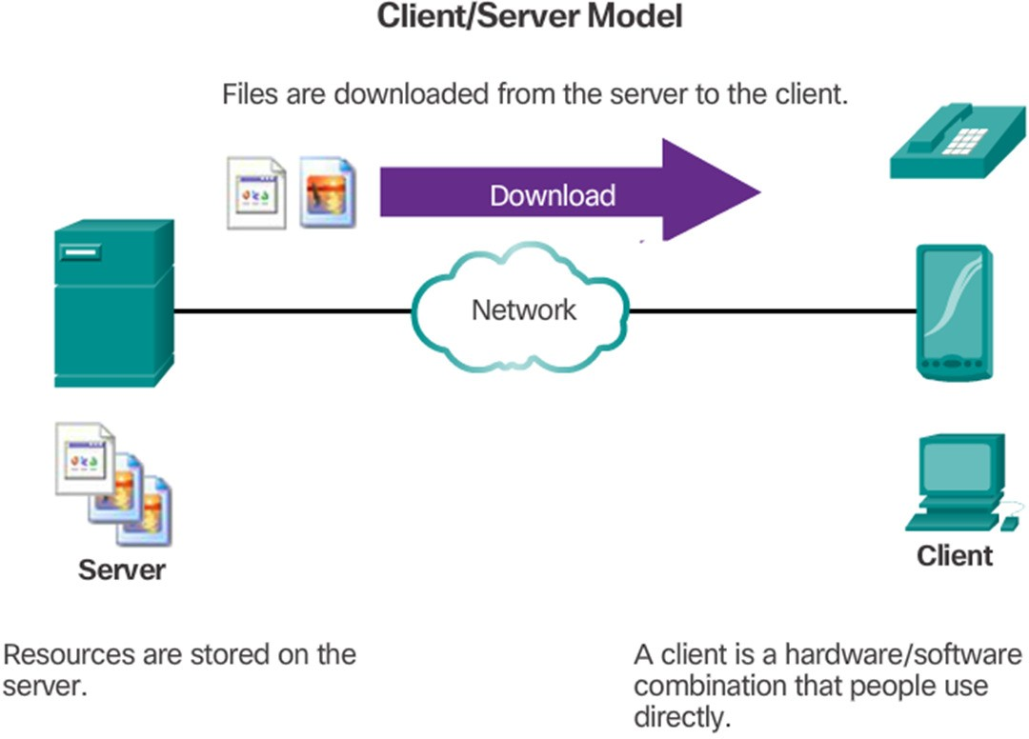
Client Server Model
Objective: Study about basic concept of Client Server & Peer to Peer model and it uses
The device requesting the information is called a client.
The device responding to the request is called a server.
Client and server processes are considered to be in the application layer.
The client initiates the exchange by requesting data from the server.
The server responds by sending one or more streams of data to the client.
Application layer protocols describe the format of the requests and responses between clients and servers.
The contents of the data exchange will depend of the application in use.
Email is an example of a Client-Server interaction.

Slide 11
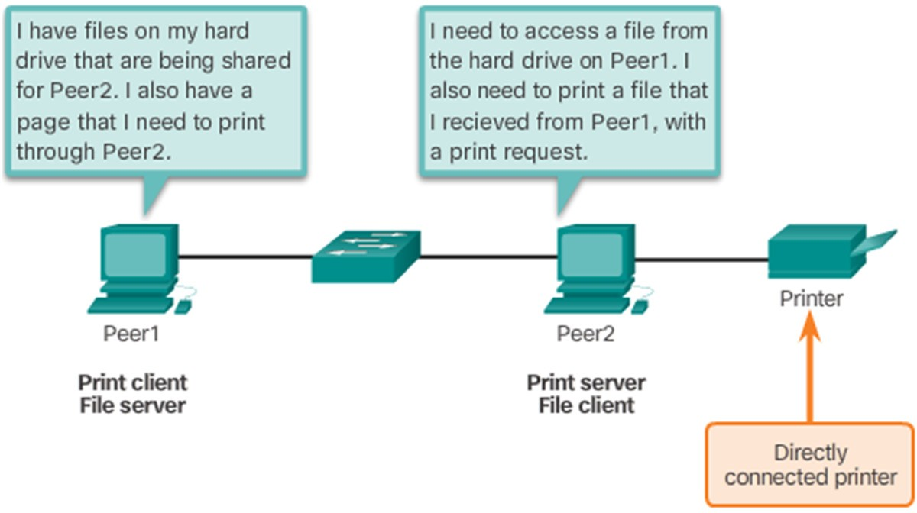
Peer to Peer Network
In the peer-to-peer (P2P) networking model, the data is accessed without the use of a dedicated server.
Two or more computers can be connected to a P2P network to share resources.
Every connected end device (a peer) can function as both a server and a client.
The roles of client and server are set on a per request basis.

Slide 12
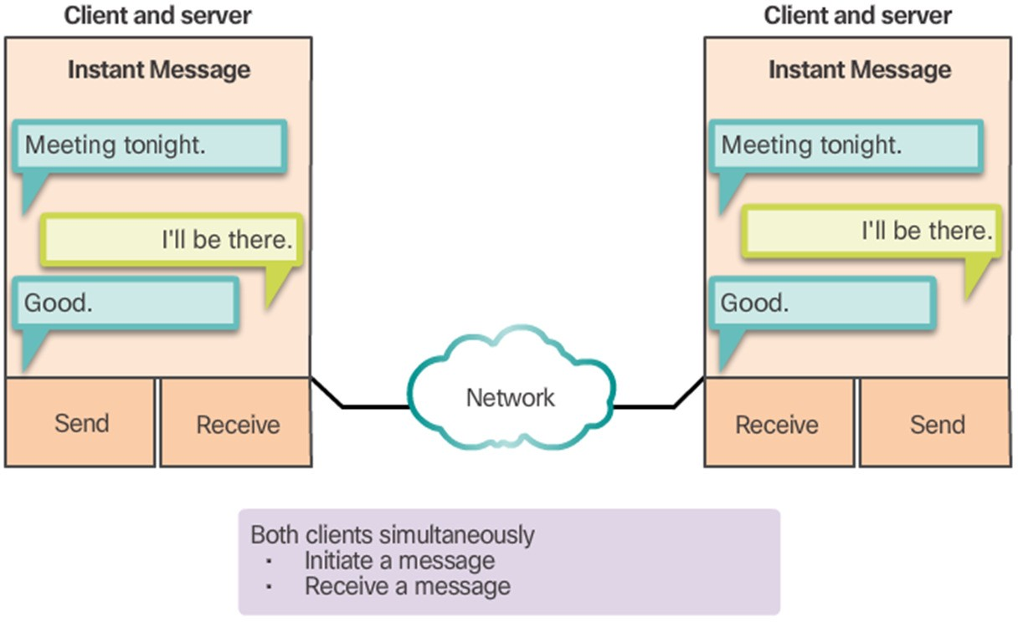
Peer to Peer applications
Some P2P applications use a hybrid system.
In hybrid P2P, resource sharing is decentralized.
Indexes that point to resource locations are stored in a centralized directory.
In a hybrid system, each peer accesses an index server to get the location of a resource stored on another peer.

Slide 13
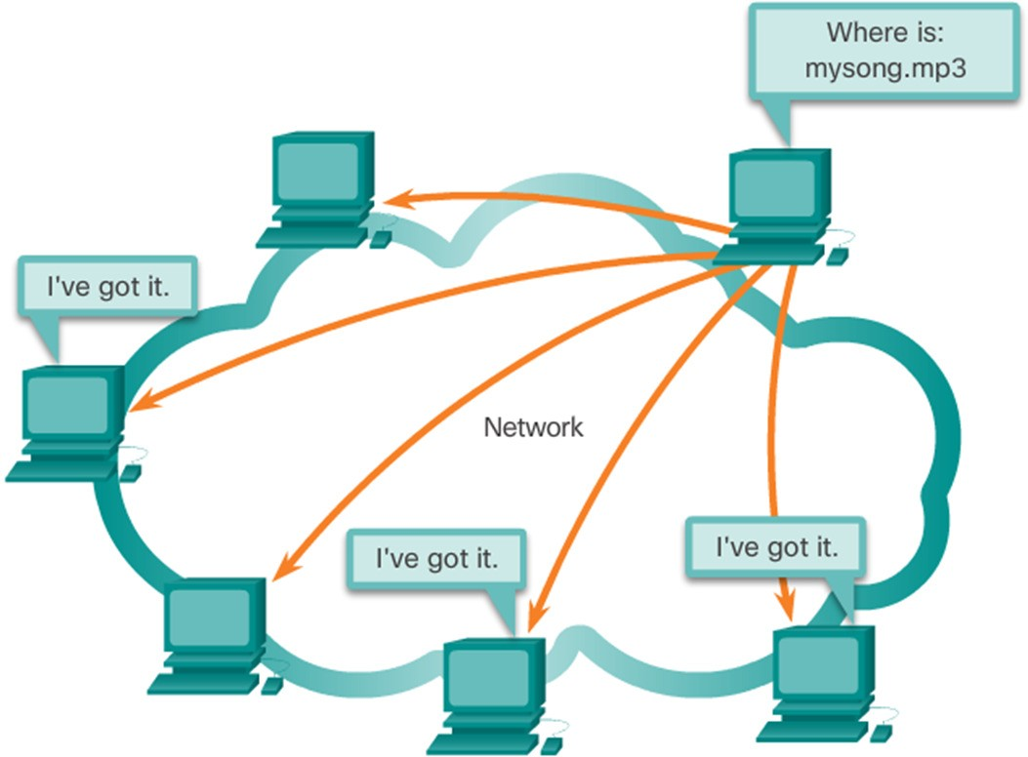
Common Peer to Peer applications
Many P2P applications allow users to share pieces of many files with each other at the same time.
A small torrent file contains information about the location of other users and tracker computers.
Trackers are computers keeping track of the files hosted by users.
This technology is called BitTorrent.
There are many BitTorrent clients, including BitTorrent, uTorrent, Frostwire, and qBittorrent.

Slide 14
Application Layer Protocols
DNS – Matches domain names with IP addresses
HTTP – Used to transfer data between clients/servers using a web browser
SMTP & POP3 – used to send email messages from clients to servers over the internet
IMAP – used to retrieve email messages
FTP – allows the download/upload of files between a client/server
Telnet – allows users to login to a host from a remote location and take control as if they were sitting at the machine (virtual connection)
DHCP – assigns IP addresses, subnet masks, default gateways, DNS servers, etc. To users as they login the network
Objective: Study about basic concept of Application layer protocols

Slide 15
Common Port Numbers
▪ TCP Ports
FTP – 20-21
Telnet – 23
SMTP – 25
DNS – 53 (Both TCP &UDP) HTTP – 80
▪ UDP Ports
DHCP – 67 & 68
POP – 110

Slide 16
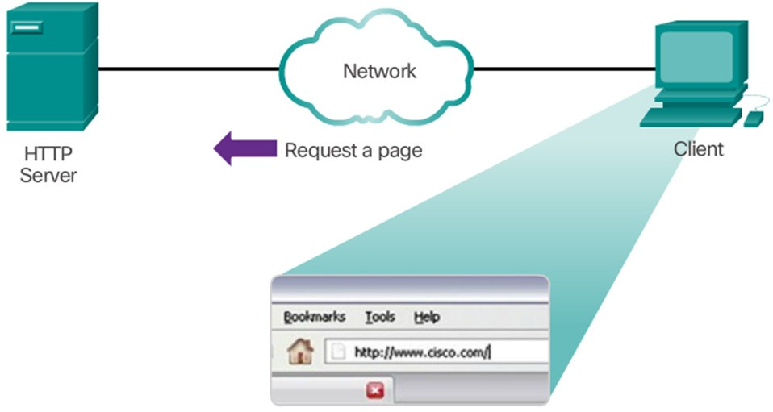
Hypertext transfer protocol and markup language
A web address or uniform resource locator (URL) is a reference to a web server. A URL allows a web browser to establish a connection to that web server.
URLs and Uniform Resource Identifier (URIs) are the names most people associate with web addresses.
The URL http://google.com/index.html has three basic parts:
HTTP Protocol Step 1
http (the protocol or scheme)
www.google.com (the server name)
index.html (the specific filename requested)
Using DNS, the server name portion of the URL is then translated to the associated IP address before the server can be contacted.

Slide 17
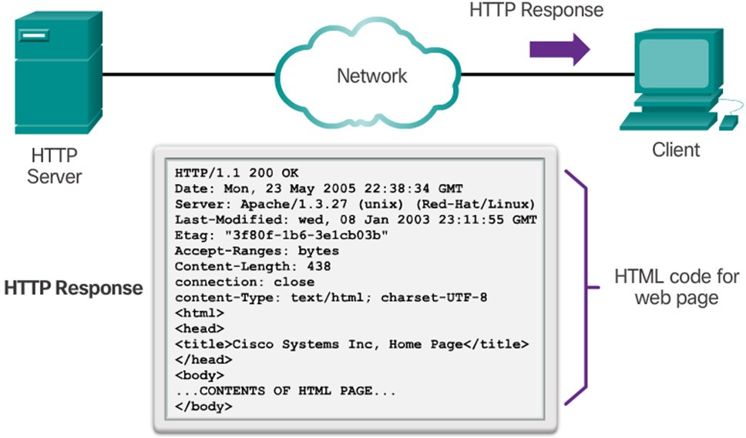
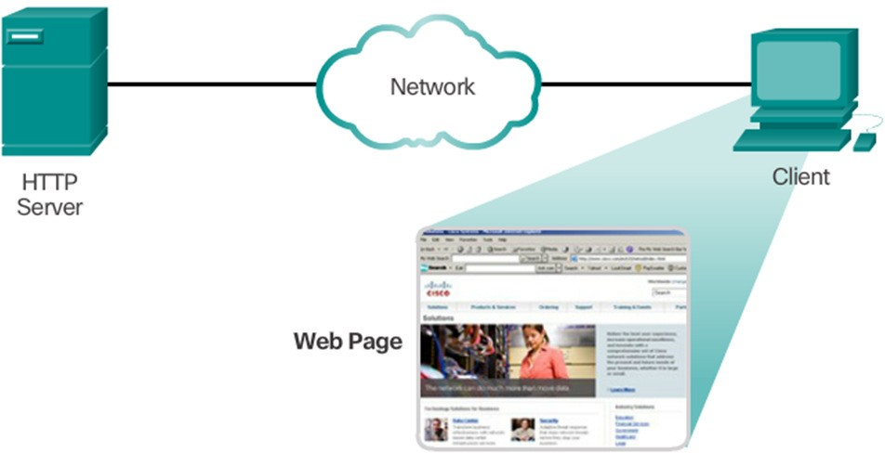
HTTP Protocol Step 2
Hypertext transfer protocol and markup language
The browser sends a GET request to the server’s IP address and asks for the index.html file.
The server sends the requested file to the client.
The index.html was specified in the URL and contains the HTML code for this web page.
HTTP Protocol Step 3
The browser processes the HTML code and formats the page for the browser window based on the code in the file.

Slide 18
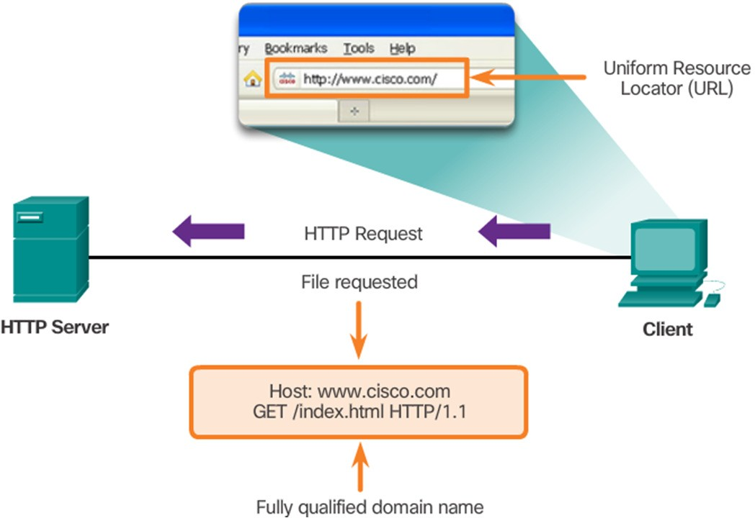
Hypertext transfer protocol
HTTP
Is a request/response protocol.
Has three common message types: GET, POST, PUT.
Is not secure. Messages can be intercepted.
HTTPS uses authentication and encryption to secure data.

Slide 19
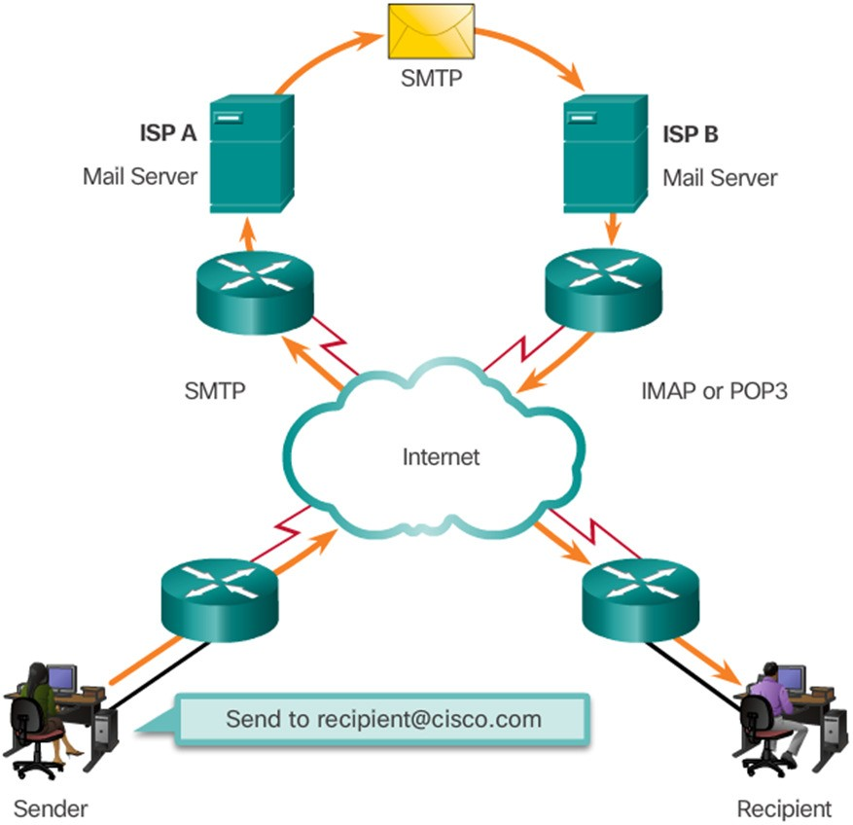
Email Protocols
Email is a store-and-forward method of sending, storing, and retrieving electronic messages.
Email messages are stored in databases on mail servers.
Email clients communicate with mail servers to send and receive email.
Mail servers communicate with other mail servers to transport messages from one domain to another.
Email clients do not communicate directly when sending email.
Email relies on three separate protocols
for operation:
SMTP (sending),
POP (retrieving),
IMAP (retrieving).

Slide 20
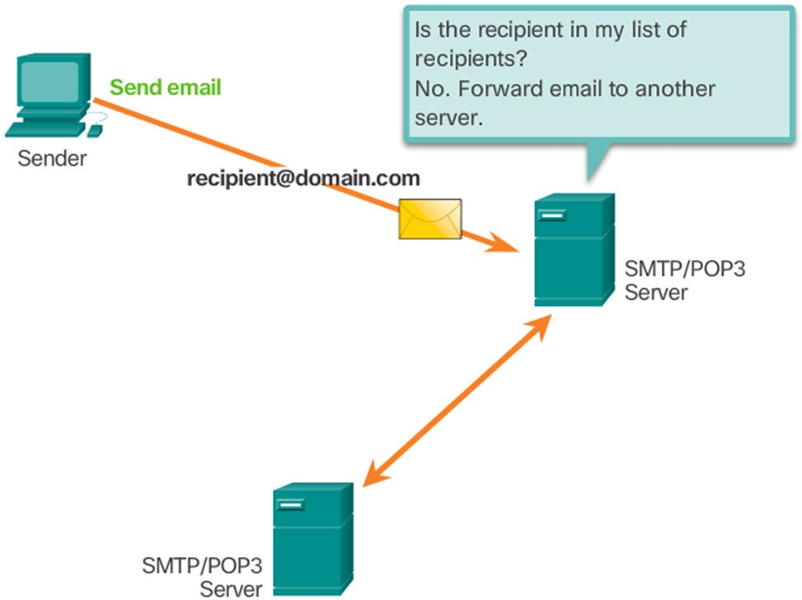
SMTP Operation
SMTP message formats require a message header and body.
The body can contain any amount of text.
The header must have a properly formatted recipient email address and a sender address.
An SMTP client sends an email by connecting to a SMTP server on port 25.
The server receives the message and stores it message in a local mailbox or relays the message to another mail server.
Users use email clients to retrieve messages stored on the server.
IMAP and POP are two protocols commonly used by email clients to retrieve messages.

Slide 21
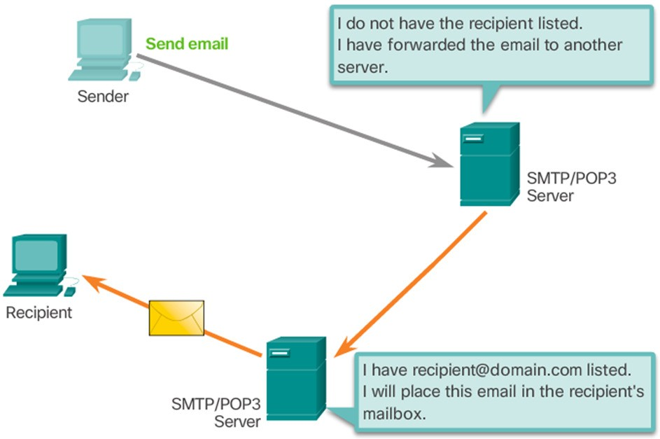
POP Operation
Messages are downloaded from the server to the client.
The server listens on port 110 TCP for client requests.
Email clients direct their POP requests to mail servers on port TCP 110.
The POP client and server exchange commands and responses until the connection is closed or aborted.
POP allows for email messages to be downloaded to the client’s device (computer or phone) and removed from the server.
There is no centralized location where email messages are kept.
A downloaded message resides on
the device that triggered the download.

Slide 22
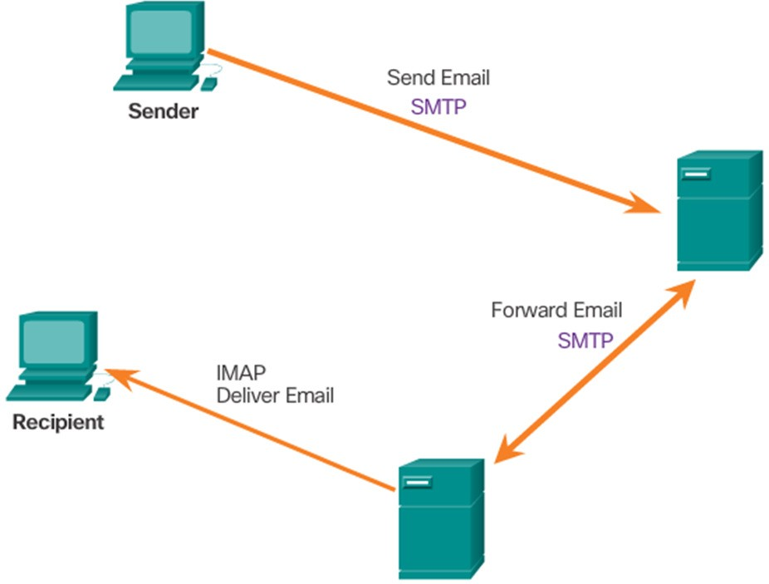
IMAP Operation
IMAP is another protocol used to retrieve email messages.
Allows for messages to be displayed to the user rather than downloaded.
The original messages reside on the server until manually deleted by the user.
Users view copies of the messages in their email client software.
Users can create a folder hierarchy on the server to organize and store mail.
That file structure is displayed on the email client.
When a user decides to delete a message, the server synchronizes that action and deletes the message from the server.

Slide 23
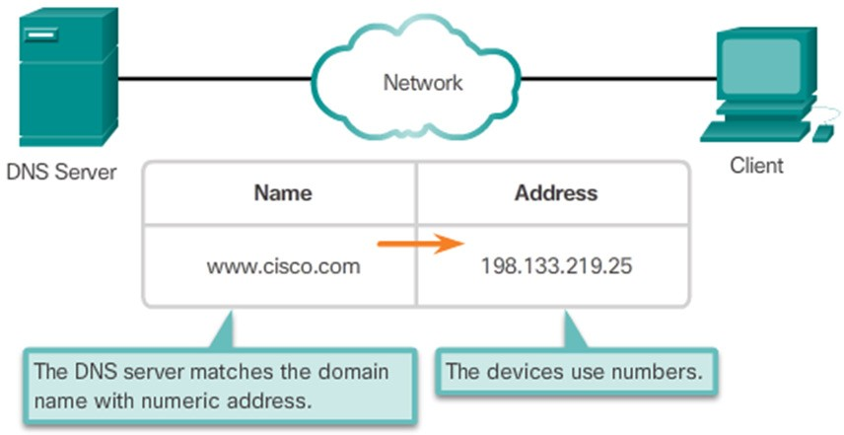
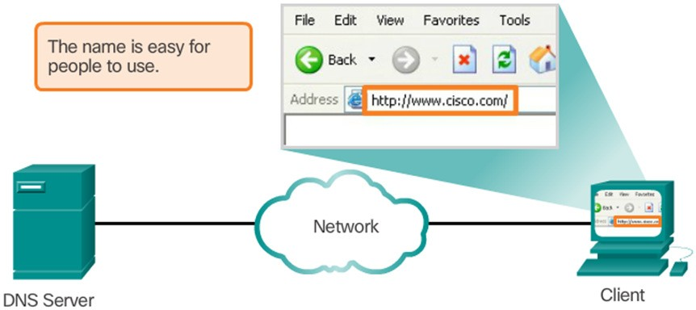
Domain name system
While IP addresses are crucial for network communication, they are not easy to memorize.
Domain names are created to make server addresses more user- friendly.
Domain names such as http://www.google.com are user-friendly addresses associated with the IP address of a specific server.
However, computers still need the actual numeric address before they can communicate.

Slide 24
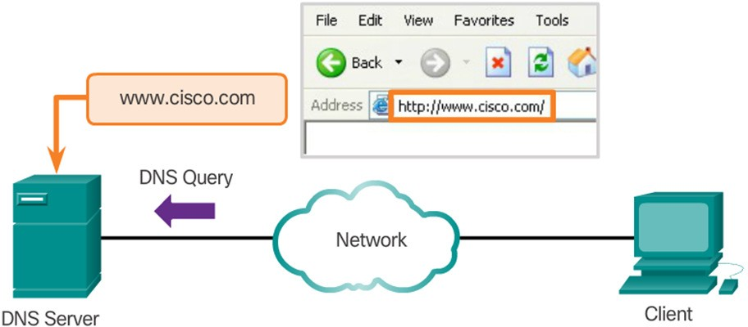
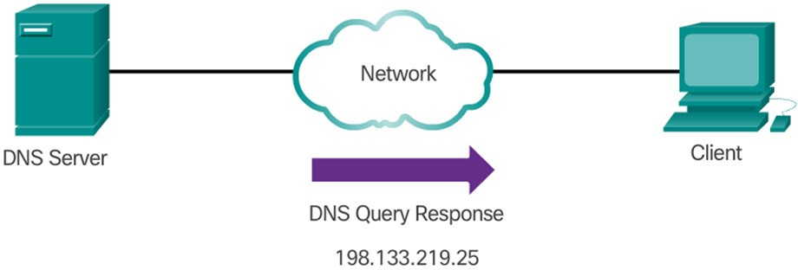
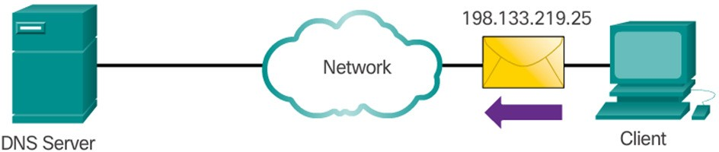
Domain name system
The DNS protocol allows for the dynamic translation of a domain name into the correct IP address.
The DNS protocol communications using a single format called a message.

Slide 25
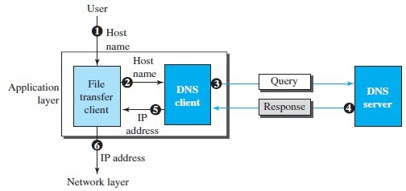
Domain name server
The user passes the host name to the file transfer client.
The file transfer client passes the host name to the DNS client.
Each computer, after being booted, knows the address of one DNS server. The DNS client sends a message to a DNS server with a query that gives the file transfer server name using the known IP address of the DNS server.
The DNS server responds with the IP address of the desired file transfer server. The DNS server passes the IP address to the file transfer client.
The file transfer client now uses the received IP address to access the file transfer Server.

Slide 26
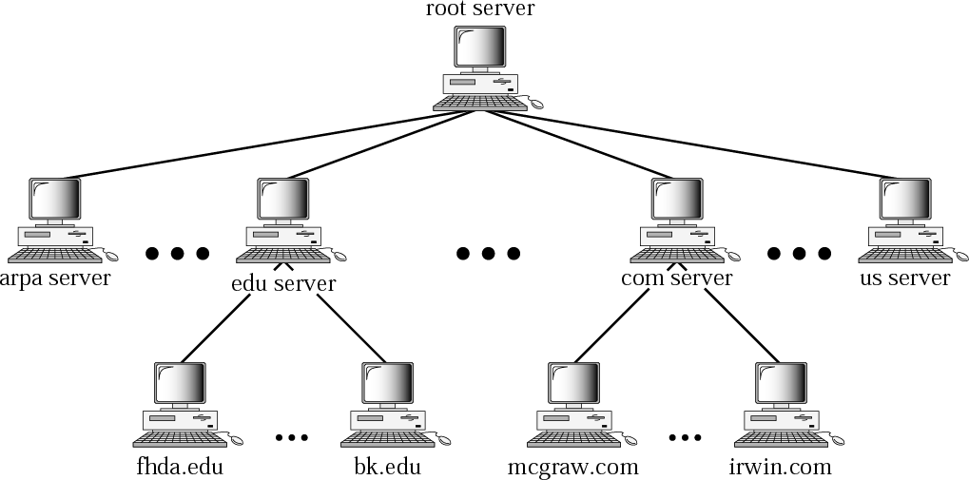
Domain name server
Stores domain name space information within its domain/sub- domain.

Slide 27
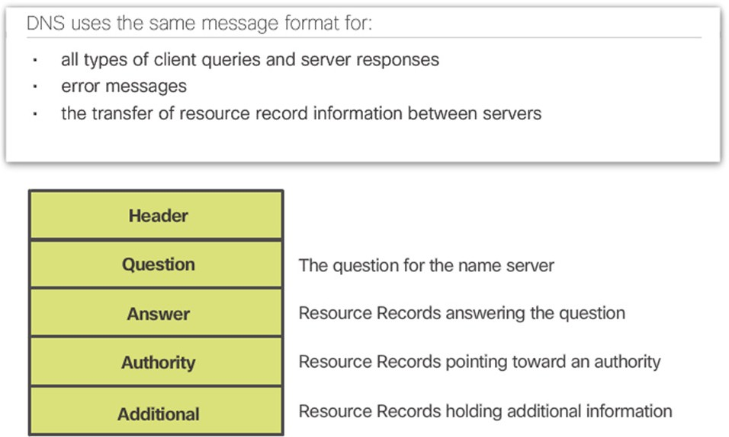
DNS Records
DNS supports different types of records. Some of these record types are:
A - An end device IPv4 address
NS - An authoritative name server
AAAA - An end device IPv6 address (pronounced quad-A)
MX - A mail exchange record
DNS servers will first look at its own records to resolve the name. If the server is unable to resolve the name using its locally stored records, it relays the query to other servers.
The response is then forwarded to the requesting client.
The DNS Client service on Windows PCs also stores previously resolved names in memory.
ipconfig /displaydns displays all of the cached DNS entries on Windows.

Slide 28
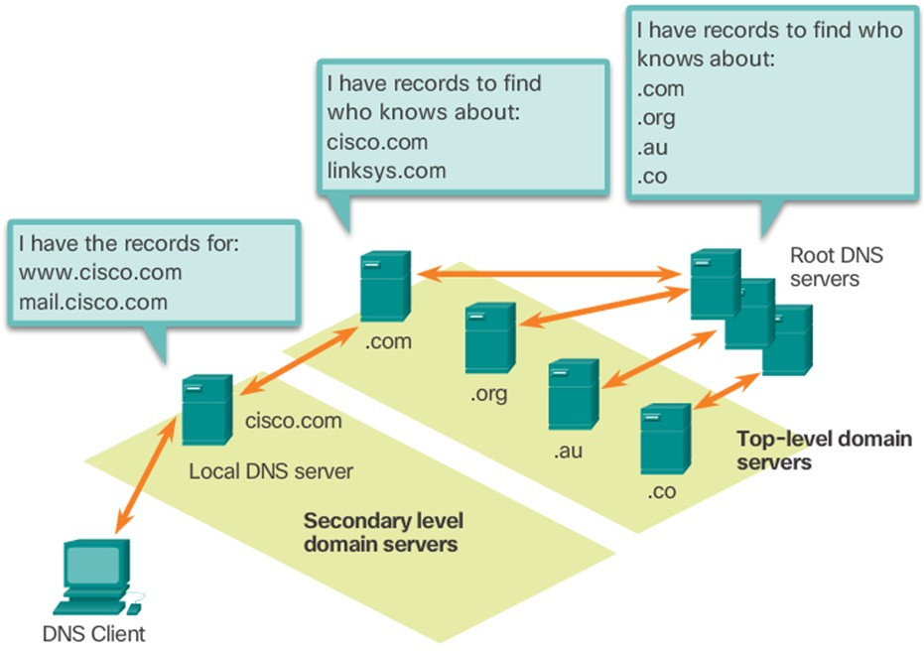
DNS Hierarchy
The DNS protocol uses a hierarchical system, with the root at the top and branches below. The naming structure is broken down into small, manageable zones.
Each DNS server is only responsible for managing name-to-IP mappings for that small portion of the DNS structure.
Requests for zones not stored in a specific DNS server are forwarded to other servers for translation.
Top-level domains represent either the type of domain or the country of origin. Examples of top-level domains are:
.com - a business or industry
.org - a non-profit organization
.au - Australia
.co - Colombia

Slide 29
Working of DNS
1. DNS is a client/server network communication protocol. DNS clients send requests to the server while DNS servers send responses to the client.
2. Client requests contain a name which is converted into an IP address known as a forward DNS lookups while requests containing an IP address which is converted into a name known as reverse DNS lookups.
3. DNS implements a distributed database to store the name of all the hosts available on the internet.
4. If a client like a web browser sends a request containing a hostname, then a piece of software such as DNS resolver sends a request to the DNS server to obtain the IP address of a hostname. If DNS server does not contain the IP address associated with a hostname, then it forwards the request to another DNS server. If IP address has arrived at the resolver, which in turn completes the request over the internet protocol.

Slide 30
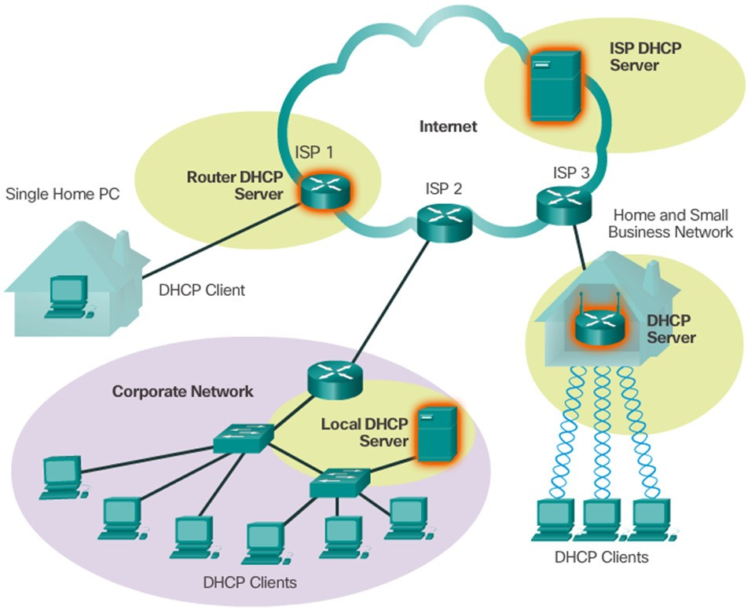
Dynamic Host Configuration Protocol
Computers need network addresses to communicate over a network.
Additional crucial information includes gateway address, subnet mask, and DNS server.
Manually configuring end devices is not scalable. DHCP allows for automated distribution of network information.
DHCP-distributed addresses are leased for a set period of time.
Addresses are returned to the pool for reuse when no longer in use.
DHCP supports IPv4 and DHCPv6 supports IPv6.

Slide 31
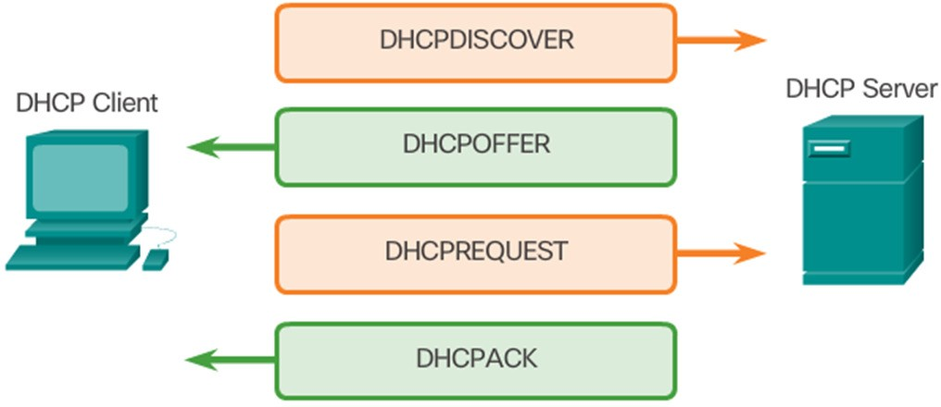
Dynamic Host Configuration Protocol Operation
A DHCP client goes through the following basic steps to request an IP:
The client broadcasts a DHCPDISCOVER.
A DHCP server replies with a DHCPOFFER message
The client sends a DHCPREQUEST message to the server it wants to use (in case of multiple offers).
A client may also choose to request an address that it had previously been allocated by the server.
The server returns a DHCPACK message to confirm the lease has been finalized.

Slide 32
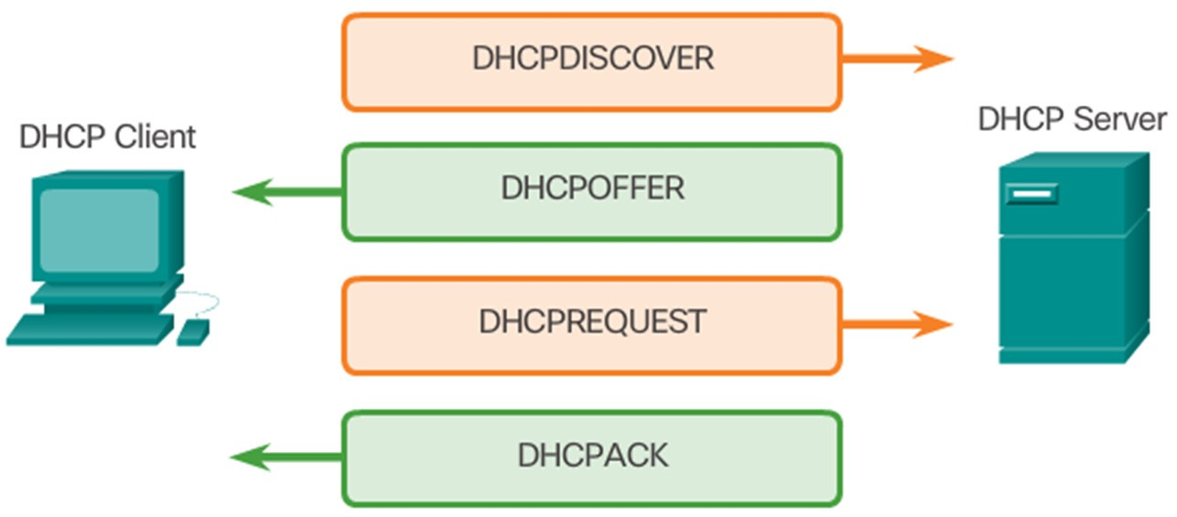
Dynamic Host Configuration Protocol Operation
The server would respond with a DHCPNAK if the offer is no longer valid
Leases must be renewed before its expiration through another DHCPREQUEST.
DHCPv6 has a similar set of messages:
SOLICIT
ADVERTISE
INFORMATION REQUEST
REPLY

Slide 33
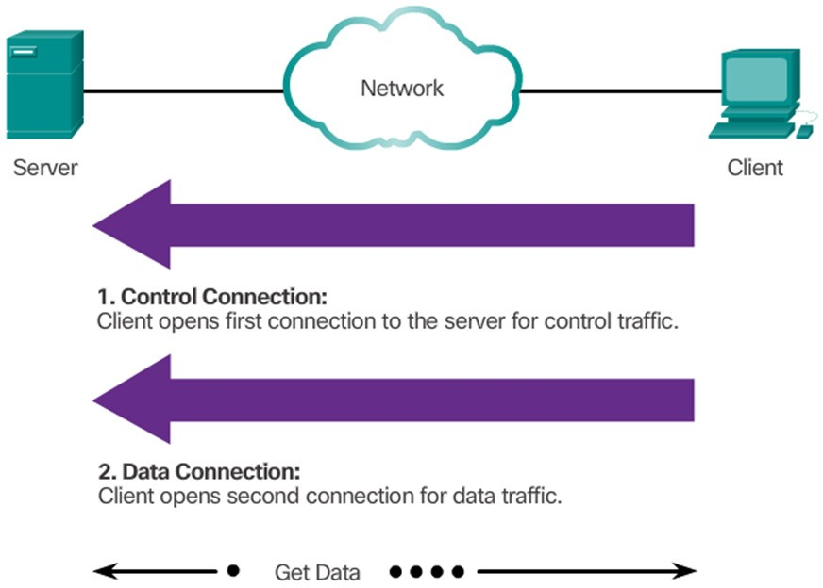
File transfer Protocol(FTP)
FTP was developed to allow the transfer of files over the network.
An FTP client is an application that runs on a client computer used to push and pull data from an FTP server.
FTP requires two connections between the client and the server: one connection for commands and replies and another connection for the actual file transfer.
The client initiates and establishes the first connection to the server for control traffic on TCP port 21.
The client then establishes the second connection to the server for the actual data transfer on TCP port 20.
The client can download (pull) data from
the server or upload (push) data to the server.

Slide 34
Telnet
Developed in the early 1970’s – among the oldest of the application layer protocols and services in the TCP/IP protocol suite.
Allows users to follow text-based terminal devices over the network using software.
A connection is known as a ‘virtual terminal (vty)’ session.
Can be run from the command prompt on a PC.
You can use the device as if you were sitting there with all the rights and priorities that you username will offer you.
TELNET requires a logging name and password, it is vulnerable to hacking because it sends all data including the password in plaintext (not encrypted). A hacker can eavesdrop and obtain the logging name and password. Because of this security issue, the use of TELNET has diminished in favor of another protocol, Secure Shell (SSH).

Slide 35
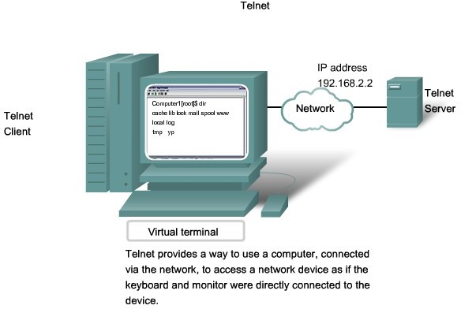
Telnet

Slide 36
Faculty Video Links, Youtube & NPTEL Video Links and Online Courses Details
Self Made Video Link:
Youtube/other Video Links
https://www.youtube.com/watch?v=8An0dRalJeM

Slide 37
Daily Quiz
Which application-level protocol plays a crucial role in carrying out the data definition and manipulation in addition to X-500 features? (CO3) a. TCP b. LDAP c. FTP d. None of the above
2. Common gateway interface is used to (CO3)
a) generate executable files from web content by web server
b) generate web pages
c) stream videos
d) none of the mentioned

Slide 38
Weekly Assignment
Explain functions of session layer (CO3)
List the name of Application Layer Protocols (CO3)
Explain the working of DNS server (CO3)
How Telnet works ? (CO3)

Slide 39
MCQ s
Which intermediaries are more likely to get involved during the transfer function of an e-mail system? (CO3) a. Storage and forwarding of e-mail for certain addresses b. Act as gateways to other e-mail or messaging systems c. Both a & b d. None of the above
2. Which combinational package of layers in OSI model is equivalent to an application layer of TCP/ IP model? (CO3)
a. Transport, Session & Application Layers b. Session, Presentation & Application Layers c. Data Link, Transport & Presentation Layers d. Network, Session & Application Layers

Slide 40
MCQ s
3. URL stands for (CO3)
a) unique reference label
b) uniform reference label
c) uniform resource locator
d) unique resource locator
4. Which phase/s of POP3 allow/s an user agent to retrieve the messages as well as to mark the messages for deletion purpose? (CO3) a. Authorization Phase b. Transaction Phase c. Update Phase d. All of the above

Slide 41
Old Question Papers
https://firstranker.com/fr.php/frdA290120A17171122/download-aktu-b-tech-6th-sem-2018-2019-KCS603-computer-network-question-paper

Slide 42
Expected Questions for University Exam
Explain TFTP. (CO3)
Explain NVT. (CO3)
What are the drawbacks of POP3? (CO3)
Explain Internet mail access protocol. (CO3)
Explain the Architecture of WWW. (CO3)

Slide 43
Summary
In this unit we have studied functions of transport layer and port addressing.
TCP/UDP protocols in detail and SCTP protocol for transport Layer.
We have also covered network security issues and encryption decryption methods

Slide 44
References
Thank You
Books:
Forouzen, "Data Communication and Networking",TMH
A.S. Tanenbaum, Computer Networks, Pearson Education
W. Stallings, Data and Computer Communication, MacmillanPress

